Slide 1


Department of BES-1
Data Structure
24SC1203
Topic:
Construction OF
RED-BLACK Tree
Session - 34

Slide 2



AIM OF THE SESSION
1. The students familiar with the basic concepts of root nodes, parents and Childrens nodes with real
time examples and programming syntax.
2. These knowledge of basic concepts they can construction and demonstrate the RED-BLACK tree.
INSTRUCTIONAL OBJECTIVES
This Session is designed to:
Demonstrate RED-BLACK Tree Constructions with best, worst and average cases of time and space complexity
Describe RED-BLACK Tree basic terminology and why it is needed
List out the general ideas about RED-BLACK construction and why it is needed in data structure
Describe the structure of RED-BLACK tree constructions and its significance usages in computer science
LEARNING OUTCOMES
At the end of this session, you should be able to:
Define the concept of RED-BLACK Tree constructions phases, time and space complexity
Describe: RED-BLACK Tree constructions phases with all possible conditions
Summarize the RED-BLACK Tree importance in computer science in cases of storing and managing data

Slide 3
INTRODUCTION
A Red-Black Trees are a type of self-balancing binary search tree.
Why they are named as “Red-Black" because each node in the tree is marked with one of two colors, either red or black.
Red-Black Trees were introduced by Rudolf Bayer and Volker Strassen in 1972.
These colours are used to ensure that the tree remains balanced during insertions and deletions.

Slide 4
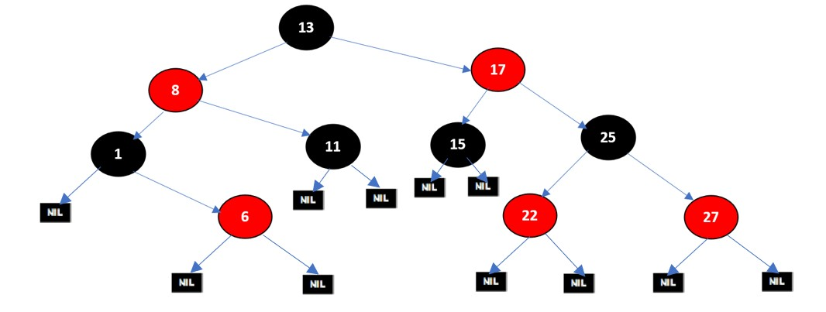
EXAMPLE OF RED-BLACK TREE
Constructing Red-Black tree with 10 nodes

Slide 5
REQUIREMENTS
A red-black tree is a Binary tree where a particular node has colour as an extra attribute, either red or black.
Red-black trees maintain a slightly looser height invariant than AVL trees.
For red-black trees, we have a different set of rules related to the colors of the nodes

Slide 6
PROPERTIES OF RED-BLACK TREE
Every node is RED or BLACK.
Root is always BLACK.
New insertions always RED.
Every path from ROOT – LEAF has same number of BLACK nodes.
No path can have 2 consecutive RED nodes.
NULL are BLACKS.

Slide 7
RULES FOR INSERTION OF NODE
If the tree is empty, make new node as root and color it with black.
If tree is not empty, create new node as leaf node and color it with red.
If parent of new node is black then exit.
If parent of new node is red then check the color of parent sibling
a) If parent sibling color is black or null rotate and recolor.
b) If parent sibling color is red, then recolor parent and parent sibling
c) And check parent's parent is not root node. Then recolor
and recheck.

Slide 8


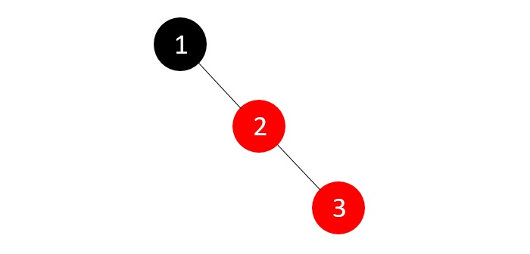
CONSTRUCTION OF RB TREES
Let's understand the inserting elements with following the red-black tree properties and rules
Construct a red black tree with 1 to 7 numbers.
1
2
3

Slide 9
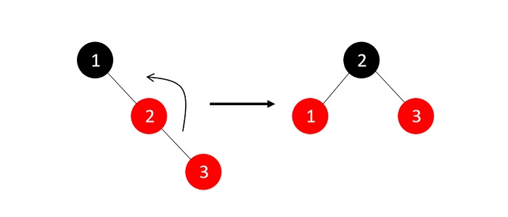
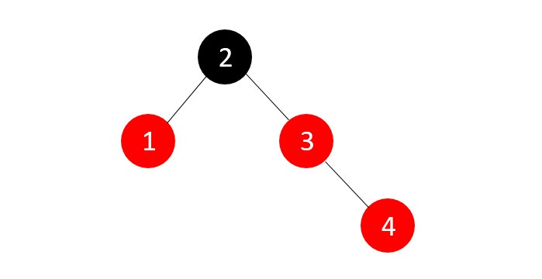
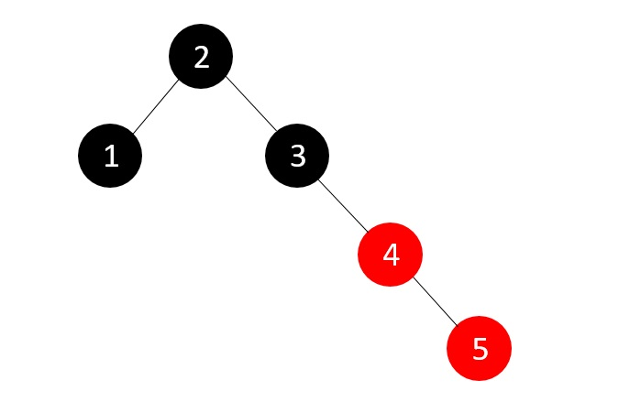
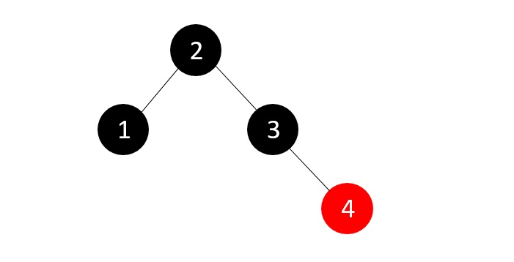
Example of RED-BLACK Tree
4
5

Slide 10
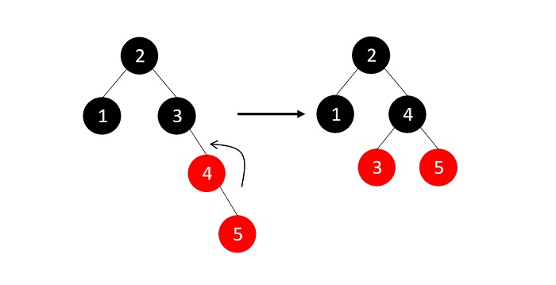
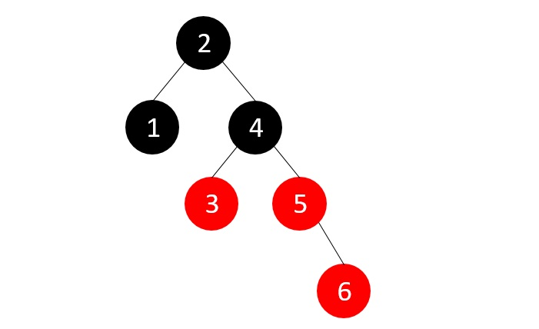
Example of RED-BLACK Tree
6

Slide 11
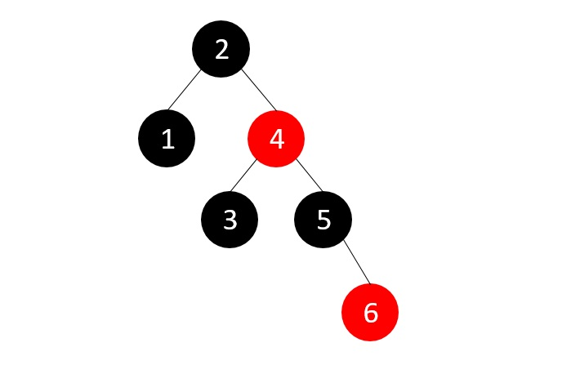
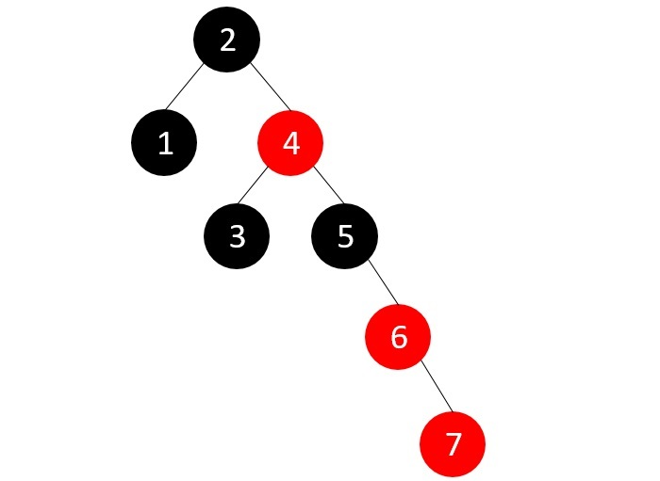
Example of RED-BLACK Tree
7

Slide 12
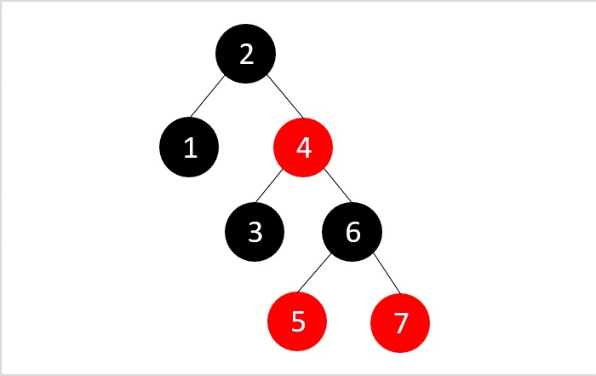
Example of RED-BLACK Tree
t
The final Red Black Tree with 1 to 7 Numbers

Slide 13
ADVANTAGES
Red Black Trees have a guaranteed time complexity of O(log n) for basic operations like insertion, deletion, and searching.
Red Black Trees are self-balancing.
Red Black Trees can be used in a wide range of applications due to their efficient performance and versatility.
The process which is used to maintain balance in Red Black Trees is relatively simple and easy to understand.

Slide 14
DISADVANTAGES
A red black trees in a lot of cases is that it is a binary tree and thus lookups are O(log(n)) where as hash tables have a lookup of O(1).
Red Black Trees require one extra bit of storage for each node to store the color of the node (red or black).
Complexity of Implementation.
Although Red Black Trees provide efficient performance for basic operations, they may not be the best choice for certain types of data or specific use cases.

Slide 15
EXAMPLE
1. Describe RED –BLACK tree with proper syntax and example
2. Construct the RED-BLACK tree with these elements
a) 10,85,15,70,20,60,30,50,65,80,90,40,5,55.
b) 10,18,7,15,16,30,25,40,60,2,1,70.

Slide 16
SUMMARY
The Red-Black tree properties ensure a balanced structure, limiting the longest path from the root to any leaf to at most twice the length of the shortest path.
This balance guarantees efficient average-case performance for search, insertion, and deletion operations, with a worst-case time complexity of O(log n).

Slide 17
SELF-ASSESSMENT QUESTIONS
1. What is the color of the root node in a Red-Black Tree?
A. Red
B. Black
C. Alternates between red and black
D. It has no color
2. What is the worst-case time complexity for searching a key in a Red-Black Tree?
A. O(1)
B. O(log n)
C. O(n)
D. O(n log n)
3. Which self-balancing tree structure is a common alternative to Red-Black Trees?
A. AVL Trees
B. B-Trees
C. Quad Trees
D. Binary Heaps

Slide 18
TERMINAL QUESTIONS
1.What is the color of root in red black tree?
2.What is the color property of red black tree?
3.What is the color of null node?

Slide 19
REFERENCES FOR FURTHER LEARNING OF THE SESSION
TEXTBOOKS:
  Mark Allen Weiss, Data Structures and Algorithm Analysis in C, 2010 , Second Edition, Pearson Education.
  Ellis Horowitz, Fundamentals of Data Structures in C: Second Edition, 2015
REFERENCE BOOKS:
A.V.Aho, J. E. Hopcroft, and J. D. Ullman, “Data Structures And Algorithms”, Pearson Education, First Edition Reprint2003.
Horowitz, Sahni, Anderson Freed, “Fundamentals of data structures in C” , Second Edition-2007.
R. F. Gilberg, B. A. Forouzan, “Data Structures”, Second Edition, Thomson India Edition, 2005
Robert Kruse, C.L. Tondo, Bruce Leung, Shashi Mogalla, “Data Structures & Program Design in C”, FourthEdition-2007.
WEB REFERNCES/MOOCS:
https://nptel.ac.in/courses/106102064
https://nptel.ac.in/courses/106101060/4
https://www.edx.org/course/algorithms-and-data-structures-1
https://in.udacity.com/course/intro-to-algorithms--cs215
https://www.coursera.org/learn/data-structures?action=enroll

Slide 20
THANK YOU
Team – Data structure

